Slide 1
Technology Value Stream
Justin Marucci
CSD-380
10-24-2025

Slide 2
What is the Technology Value Stream?
The overall process of building a software product to customer delivery
Includes all steps: plan → code → build → test → deploy → operate → learn
The overall goal is to deliver a quality software product

Slide 3
Lead Time vs. Processing Time
Lead Time: Total time from when a request is made until the change is delivered
Processing Time: Actual time spent working on the change
Example:
A developer might finish coding and testing a small change in just a couple hours, but that change could still take weeks to reach customers. The long delay doesn’t come from the actual work it takes to build the product; it comes from waiting.

Slide 4
The Common Scenario: Deployment Lead Times Requiring Months
In many IT environments, deploying new features or fixes can take weeks or even months. This happens because the process relies heavily on manual steps and outdated release practices.
Some causes of long lead times are:
Large Releases
Team Communication
Manual efforts (Testing and Approvals)

Slide 5
Our DevOps Ideal: Deployment Lead Times of Minutes
Modern DevOps teams have transformed how software is delivered. Instead of waiting weeks or months for a release, high-performing teams can deploy code to production multiple times per day
DevOps teams are more automated, so delivery to the customer has never been better
Thanks to DevOps processes code can flow into production in minutes

Slide 6
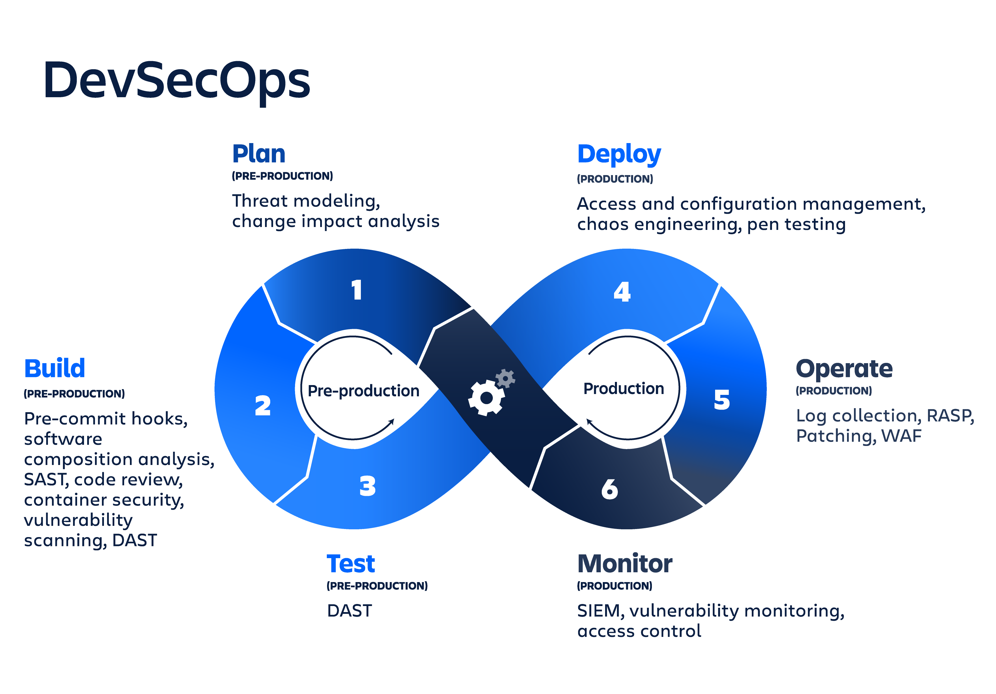

Slide 7
Sources
Atlassian. (n.d.). What is value stream mapping? Atlassian. https://www.atlassian.com/continuous-delivery/principles/value-stream-mapping
BrowserStack. (2025, July 10). DevOps lifecycle: Different phases in DevOps. Retrieved October 24, 2025, from https://www.browserstack.com/guide/devops-lifecycle
CloudBees. (n.d.). Value stream management: How to measure DevOps performance & faster software delivery.https://www.cloudbees.com/blog/value-stream-management-how-measure-devops-performance-faster-software-delivery
Copado. (n.d.). The 3 pillars of DevOps value stream management. https://www.copado.com/resources/blog/the-3-pillars-of-devops-value-stream-management
DevOps Institute. (n.d.). Value stream management: Explained in plain English. https://www.devopsinstitute.com/value-stream-management-explained-in-plain-english/
IT Revolution. (2024). Cycle time vs. lead time: A comprehensive guide. https://itrevolution.com/articles/cycle-time-vs-lead-time/
Kim, G., Humble, J., Debois, P., Willis, J., & Allspaw, J. (2016). The DevOps handbook: How to create world-class agility, reliability, & security in technology organizations (2nd ed.). IT Revolution Press.
LinearB. (n.d.). Value stream mapping in a DevOps team. https://linearb.io/blog/value-stream-mapping-devops
OpenAI. (2025). ChatGPT (October 24 version) [Large language model]. https://chat.openai.com
Software.com. (n.d.). Lead time and how to measure it in DevOps. https://www.software.com/devops-guides/lead-time

